Slide 1
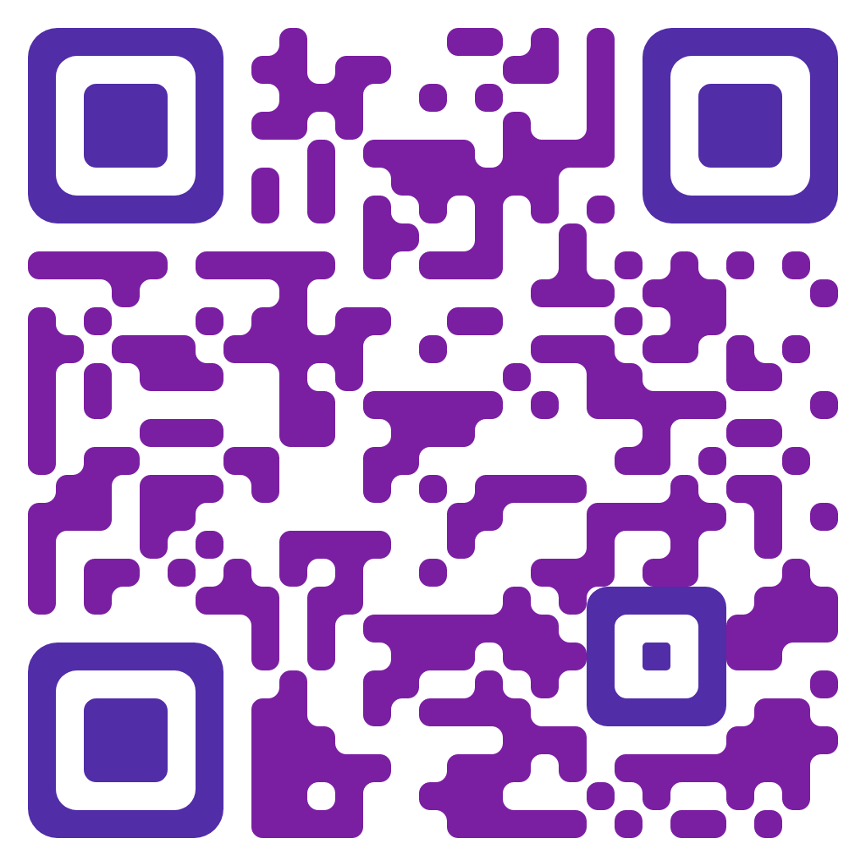
kubernetes training course – Oct 2022
author: viettq
Checkin

Slide 2
kubernetes training course – Oct 2022
author: viettq
Agenda
Review
Service
Service type
Practice
Summary

Slide 3
kubernetes training course – Sep 2022
author: viettq
REVIEW
Deployment
Replicaset

Slide 4
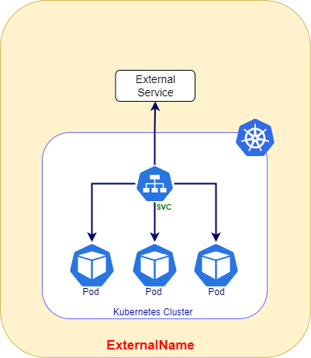
kubernetes training course – Sep 2022
author: viettq
kubernetes service

Slide 5
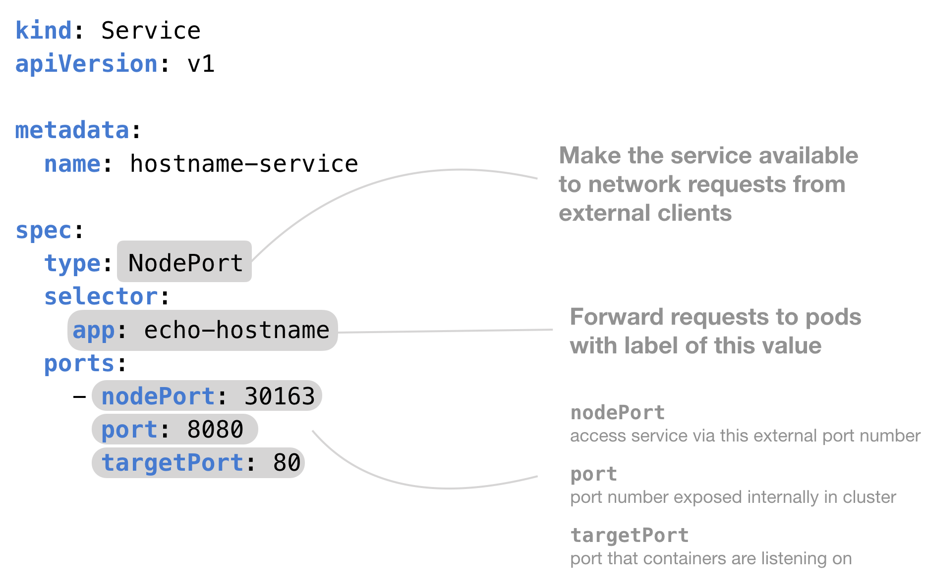
kubernetes training course – Sep 2022
author: viettq
Service components
kubernetes service

Slide 6
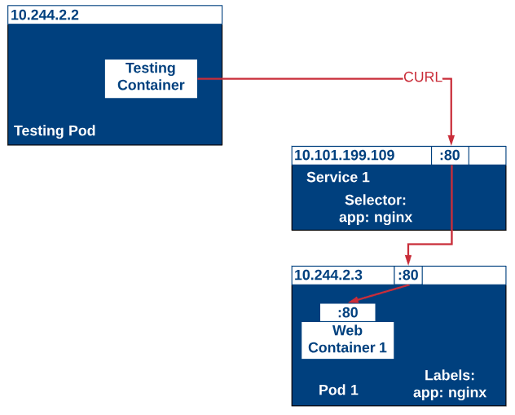
kubernetes training course – Sep 2022
author: viettq
Selector & endpoints
kubernetes service

Slide 7
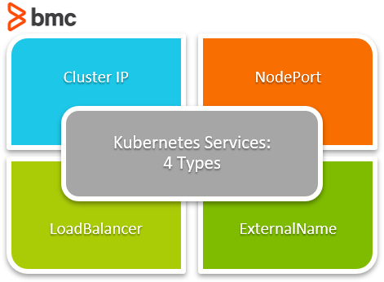
kubernetes training course – Sep 2022
author: viettq
Service types
kubernetes service

Slide 8
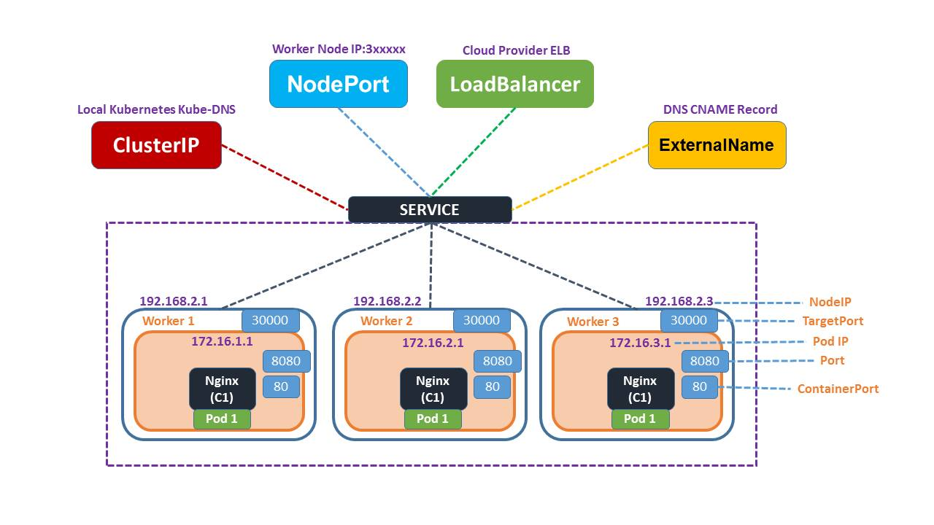
kubernetes training course – Sep 2022
author: viettq
Service types
kubernetes service

Slide 9
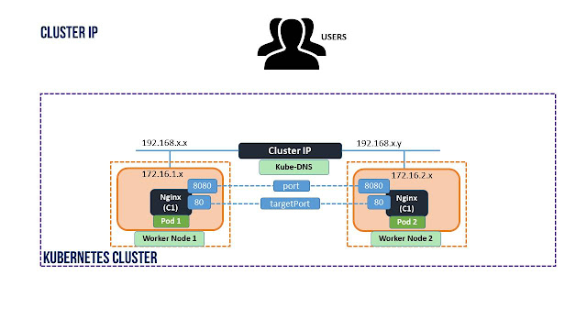
kubernetes training course – Sep 2022
author: viettq
clusterip
kubernetes service

Slide 10
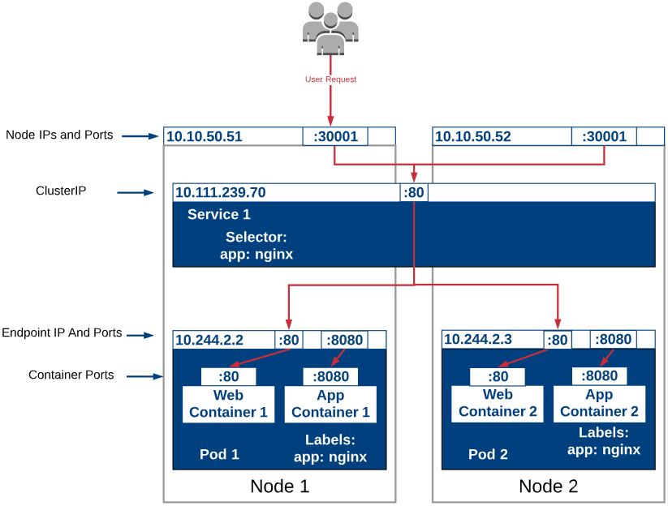
kubernetes training course – Sep 2022
author: viettq
Selector & endpoints
kubernetes service

Slide 11
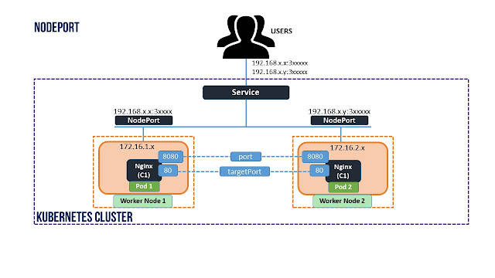
kubernetes training course – Sep 2022
author: viettq
nodeport
kubernetes service

Slide 12
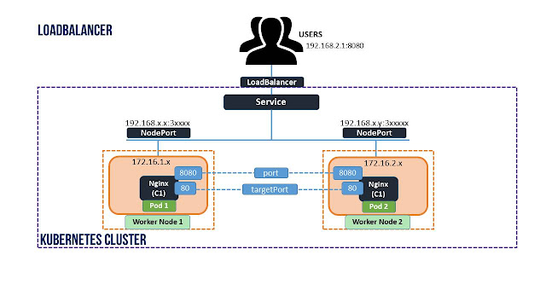
kubernetes training course – Sep 2022
author: viettq
loadbalancer
kubernetes service

Slide 13
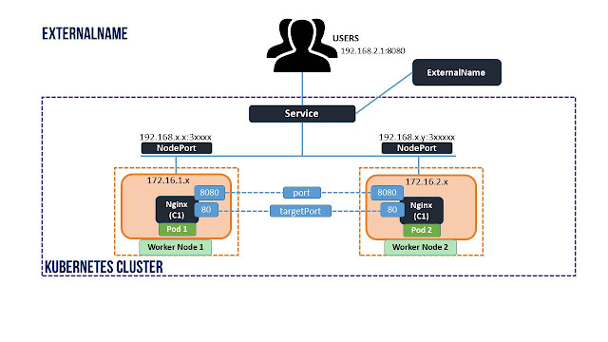
kubernetes training course – Sep 2022
author: viettq
externalname
kubernetes service

Slide 14
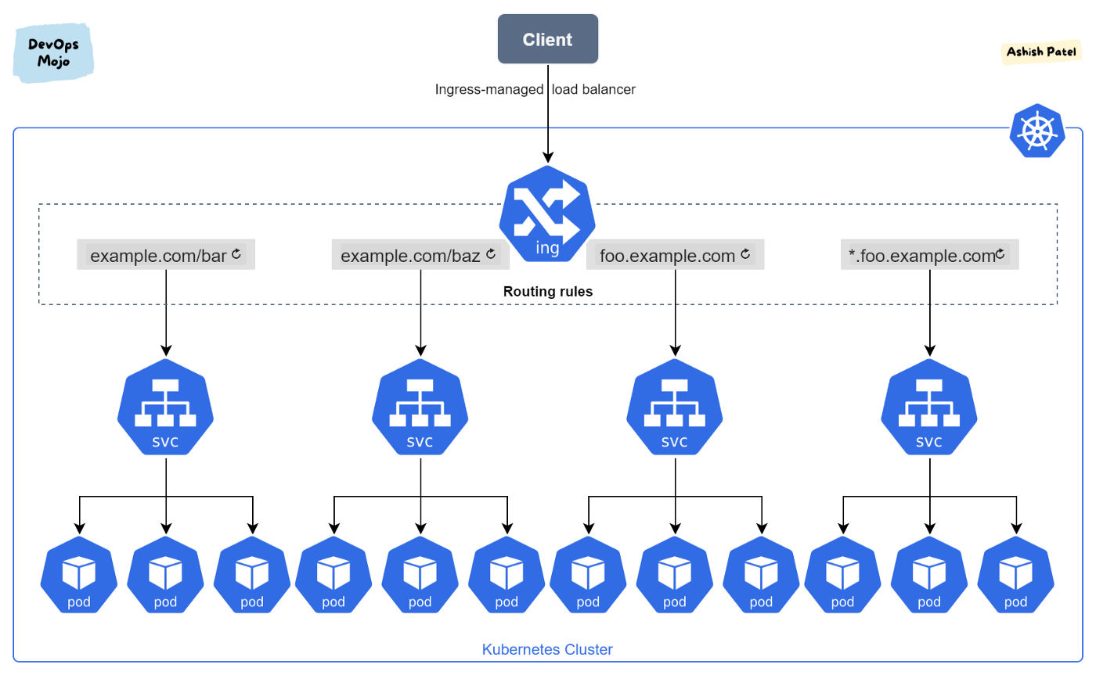
kubernetes training course – Sep 2022
author: viettq
kubernetes ingress

Slide 15
kubernetes training course – Sep 2022
author: viettq
.
Q&A
Ask me anything

